Slide 1
Classify Clothes using Tensor Flow

Slide 2

Guide name:-
Dr. L. Shakkeera
Senior Assistant Professor
SCSE

Slide 3

Presented By:-
1) Pratham Kurele(19BAI10163)
2) Manan Mittal(19BAI10171)
3) Devansh Rathi(19BAI10173)
4) Ayush Bajpai(19BAI10167)

Slide 4
Introduction
Classification is a process of categorizing a given set of data into classes. The process starts with predicting the class of given data points where the classes can be referred to as target, label, or categories.
The different types of classification algorithms are —
Linear Models
Nonlinear models

Slide 5
Existing work
It is an existing project and this helps people in many ways like -
To give information about the cloths and quantity present in their store.
It also helps people to take find out which cloths is finished so they can odder new cloths.
It basically works in a textiles industries in a similar ways instead of cloths we can replace it with different types of materials which are used in particular industries or shops.

Slide 6
Limitations
It is based on cloud so if any error is occurred or cloud is not responding then the industrialist will face problem.
The can also be hacked so probability of data loss in greater due to hack of the cloud.

Slide 7
Proposed work
Fashion-MNIST is a dataset of Zalando's article images, consisting of a training set of 60,000 examples and a test set of 10,000 examples. Each example is a 28x28 grayscale image, associated with a label from 10 classes. Zalando intends Fashion-MNIST to serve as a direct drop-in replacement for the original MNIST dataset for benchmarking machine learning algorithms. It shares the same image size and structure of training and testing splits. Zalando seeks to replace the original MNIST dataset.
Training set - 60,000 examples
Test set - 10,000 examples
Each example is a 28x28 grayscale image
10 classes

Slide 8
Methodology
First we will import data from the cloud and then run to test it in the code.
Then the we have train the code to execute the cloths classification.
Then it will tell us that how much product is available and the quantity of the product.

Slide 9
Novelty of the project
Visual classification of commercial product is a branch of under field of object detection and particular it's an important step in the creative workflow in fashion industries.
Automatically classifying garment features makes both designers and data experts aware of their overall production, which is fundamental in order to organise marketing campaigns , avoid duplicates.
There are many different techniques for visual classification, ranging from standard image processing to machine learning approaches this work is made by using TensorFlow and testing the aforementioned approaches.

Slide 10
This project describe a real world study aimed automatically recognizing strips, colors and other feature of clothing.
Specifically both deep learning and image processing techniques are used.
The result is a novel system for image recognition and feature extraction that has a high classification accuracy.

Slide 11
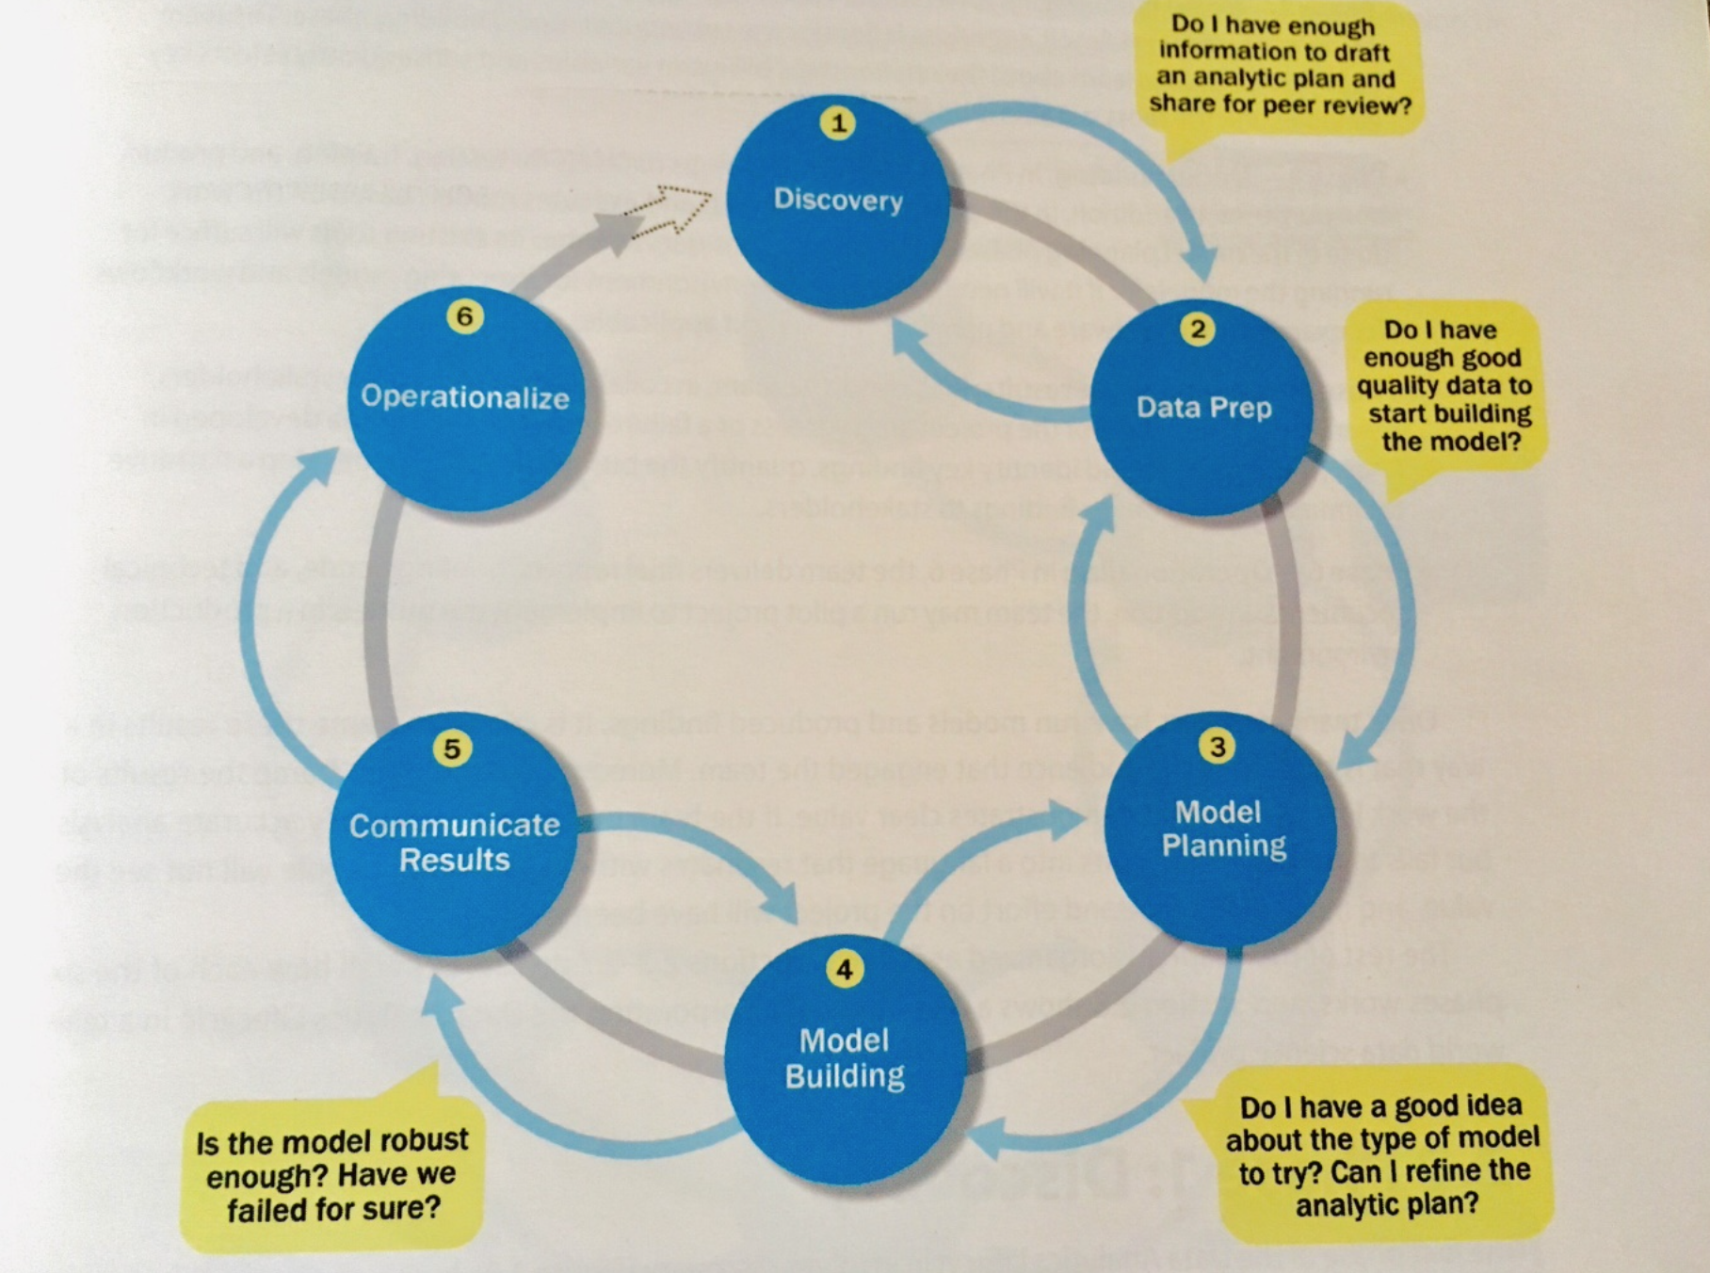

Slide 12
Real time usage
This can be used in various industries but in place of clothing the materials are inserted in place of cloths and we can use it in a same way.
This is a helpful because an industrialist will know in which product is shortage and can order the product or replace the material with other material.

Slide 13
Software and Hardware requirement
Hardware Requirements:- Workstation ( Laptop or PC), Fast-internet connection for real-time usage.
Software Requirements:- Python Compiler, and IDE such as Anaconda or Jupyter Notebook.

Slide 14
Overall System Architecture Diagram

Slide 15
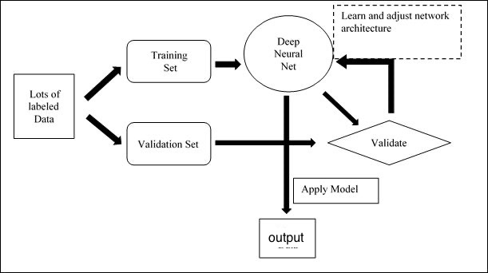

Slide 16
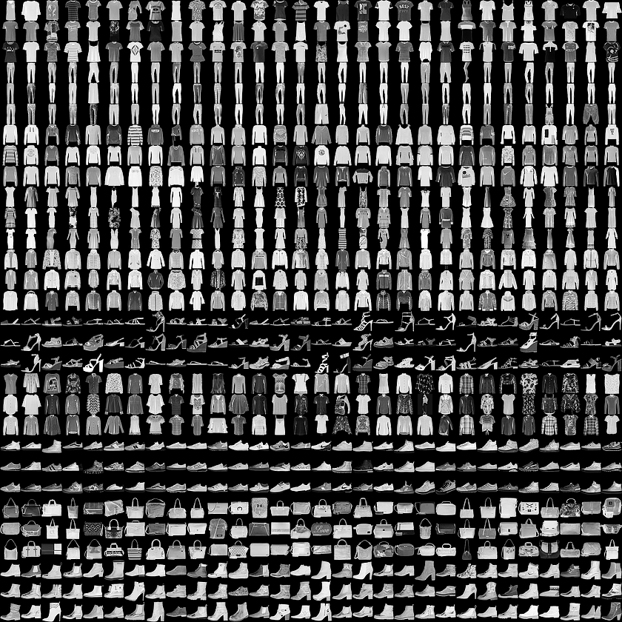
literature overview
This guide trains a neural network model to classify images of clothing, like sneakers and shirts This guide uses tf.keras, a high-level API to build and train models in TensorFlow.
Import the Fashion MNIST dataset
This guide uses the Fashion MNIST dataset which contains 70,000 grayscale images in 10 categories. The images show individual articles of clothing at low resolution (28 by 28 pixels), as seen here:

Slide 17
Merits
It can used to search in unorganized data to search for the required product.
It helps shopkeeper to keep check of their products.

Slide 18
Demerits
It can be easily hacked because hackers can take our data from the cloud.
It can not be access without the internet.
It can only be used for the people who are expert in computer.

Slide 19
Research Papers
Deep Convolutional Neural Networks for Image Classification(by MIT):-
https://www.researchgate.net/publication/317496930_Deep_Convolutional_Neural_Networks_for_Image_Classification_A_Comprehensive_Review

Slide 20
Content of Dataset
Each image is 28 pixels in height and 28 pixels in width, for a total of 784 pixels in total. - Each row is a separate image - Column 1 is the class label. - Remaining columns are pixel numbers (784 total) - Each value is the darkness of the pixel (1 to 255).

Slide 21
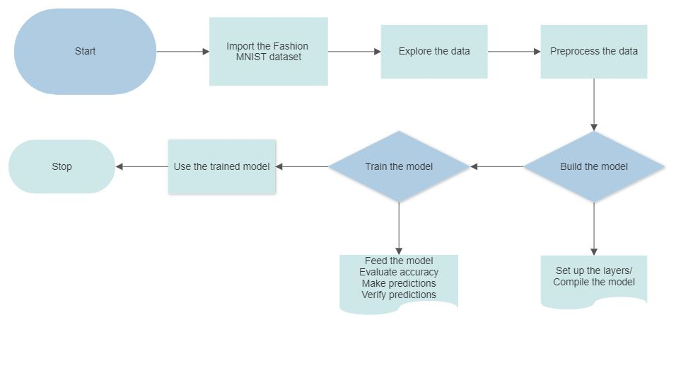

Slide 22
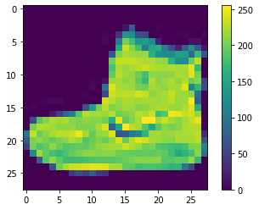
preprocess the data
The data must be preprocessed before training the network. If you inspect the first image in the training set, you will see that the pixel values fall in the range of 0 to 255:

Slide 23
BUILD THE MODEL
Set up the layers
. Layers extract representations from the data fed into them.
Building the neural network requires configuring the layers of the model, then compiling the model.
The first layer in this network, tf.keras.layers.Flatten, transforms the format of the images from a two-dimensional array (of 28 by 28 pixels) to a one-dimensional array (of 28 * 28 = 784 pixels).
The second (and last) layer returns a logits array with length of 10. Each node contains a score that indicates the current image belongs to one of the 10 classes.
Compile the model
Before the model is ready for training, it needs a few more settings. These are added during the model's compile step:
Loss function —measures accuracy of model
Optimizer —This is how the model is updated based on the data it sees and its loss function.
Metrics —Used to monitor the training and testing steps.

Slide 24
About the Dataset
Fashion-MNIST is a dataset of Zalando's article images, consisting of a training set of 60,000 examples and a test set of 10,000 examples. Each example is a 28x28 grayscale image, associated with a label from 10 classes. Zalando intends Fashion-MNIST to serve as a direct drop-in replacement for the original MNIST dataset for benchmarking machine learning algorithms. It shares the same image size and structure of training and testing splits. Zalando seeks to replace the original MNIST dataset

Slide 25
Training the model
Training the neural network model requires the following steps:
Feed the training data to the model. In this example, the training data is in the train_images and train_labels arrays.
The model learns to associate images and labels.
You ask the model to make predictions about a test set—in this example, the test_images array.
Verify that the predictions match the labels from the test_labels array.

Slide 26
Feed the model
To start training, call the model.fit method—so called because it "fits" the model to the training data:
model.fit (train_images, train_labels, epochs=10)
As the model trains, the loss and accuracy metrics are displayed. This model reaches an accuracy of about 0.91 (or 91%) on the training data.

Slide 27
Evaluate accuracy
Next, compare how the model performs on the test dataset:
test_loss, test_acc =model.evaluate (test_images, test_labels, verbose=2 )
print (‘\Test accuracy :’, test_acc)
It turns out that the accuracy on the test dataset is a little less than the accuracy on the training dataset. This gap between training accuracy and test accuracy represents overfitting. Overfitting happens when a machine learning model performs worse on new, previously unseen inputs than it does on the training data. An overfitted model "memorises" the noise and details in the training dataset to a point where it negatively impacts the performance of the model on the new data. For more information, see the following:
Demonstrate overfitting
Strategies to prevent overfitting

Slide 28
Make Prediction
With the model trained, you can use it to make predictions about some images. The model's linear outputs, logits. Attach a softmax layer to convert the logits to probabilities, which are easier to interpret.
probability_model= tf.keras.sequential ([model, tf.keras.layers.softmax( )])
predictions= probability_model.predict(test_images)
Here, the model has predicted the label for each image in the testing set. Let's take a look at the first prediction:
predictions[0]
A prediction is an array of 10 numbers. They represent the model's "confidence" that the image corresponds to each of the 10 different articles of clothing. You can see which label has the highest confidence value:
np.argmax (predictions[0])
—-> 9
So, the model is most confident that this image is an ankle boot, or test_labels[0] Examining the test label shows that this classification is correct:

Slide 29
Verify predictions
With the model trained, you can use it to make predictions about some images.

Slide 30
Thank You

